Slide 1

Using values to ACTivate your practice: Bringing meaning and purpose to therapy
Richard Bennett & Joe Oliver
Qualifications, titles, blah, blah, blah

Slide 2
Brief overview of Acceptance & Commitment Therapy (ACT)
The concept of values
Values techniques
Experiential exercises

Slide 3
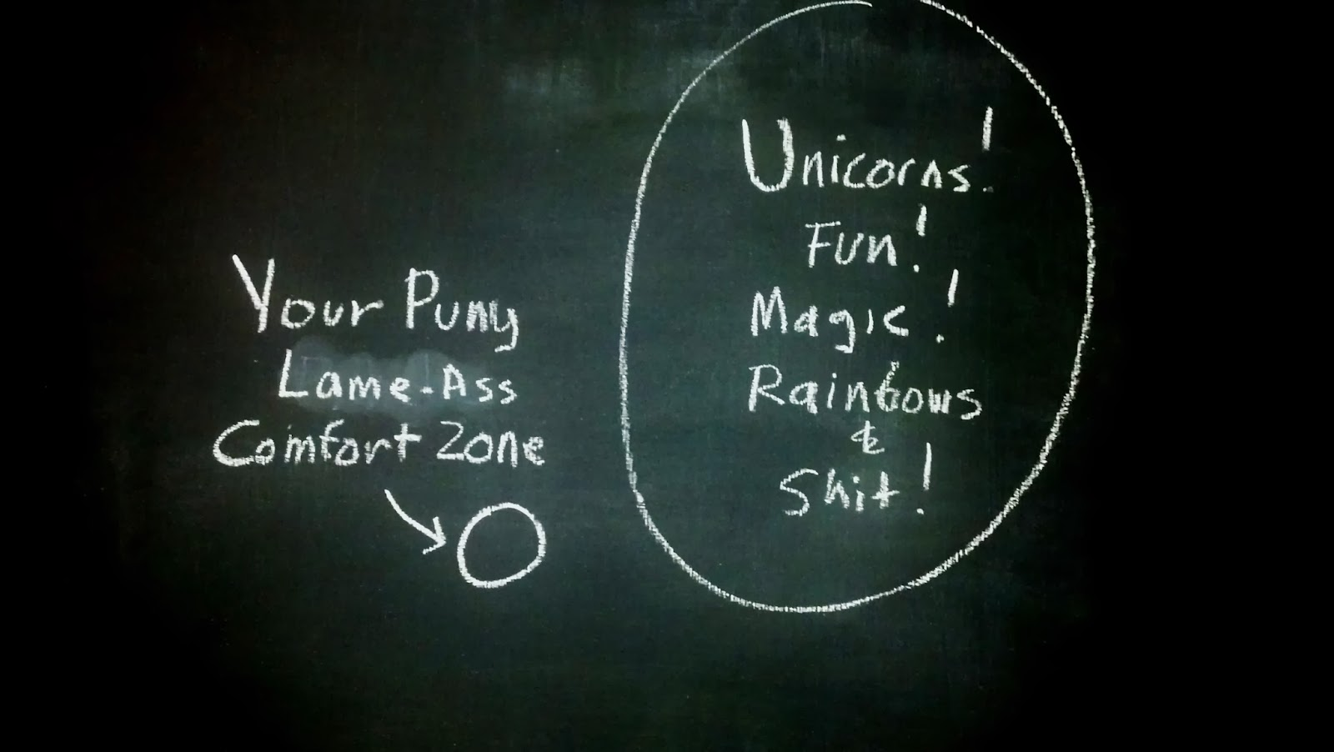

Slide 4


Slide 5
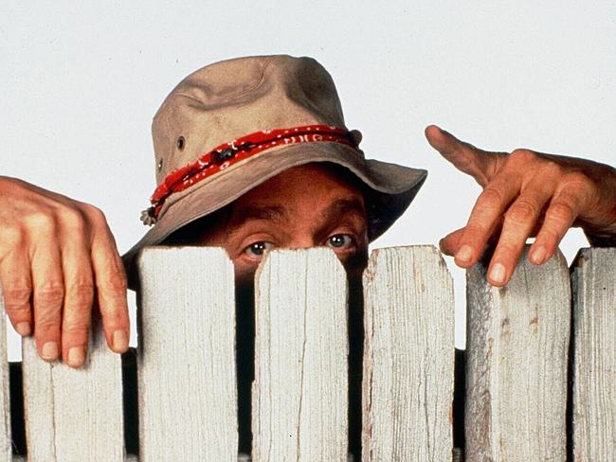
Say hello to your neighbour
Find out:
  your neighbour's name
  where he/she is from
  current job role
Invite them to share:
  One thing they do where they feel really present and engaged
  One thing they do where they feel like they are on ‘autopilot’ and not very present
5

Slide 6
The kNowledge & Experience in
ACT Determination (NERD)
Never heard of ACT
Read a little
ACT
Used ACT a bit
Used ACT a LOT
Jedi Level ACT

Slide 7

Exercise 1
Set yourself a goal for the coming week

Slide 8
200+ RCTs in ACT since 1999
work stress; pain; smoking; anxiety; depression; diabetes management; substance use; stigma toward substance users in recovery; adjustment to cancer; epilepsy; coping with psychosis; borderline personality disorder; trichotillomania; obsessive-compulsive disorder; generalized anxiety disorder; marijuana dependence; skin picking; racial prejudice; returning from war; prejudice toward people with mental health problems; whiplash associated disorders; generalized anxiety disorder; chronic pediatric pain; weight-maintenance and self-stigma; exercise; chess playing; tinnitus; eating disorders; clinicians’ adoption of evidence-based pharmacotherapy; training clinicians in psychotherapy methods other than ACT.

Slide 9
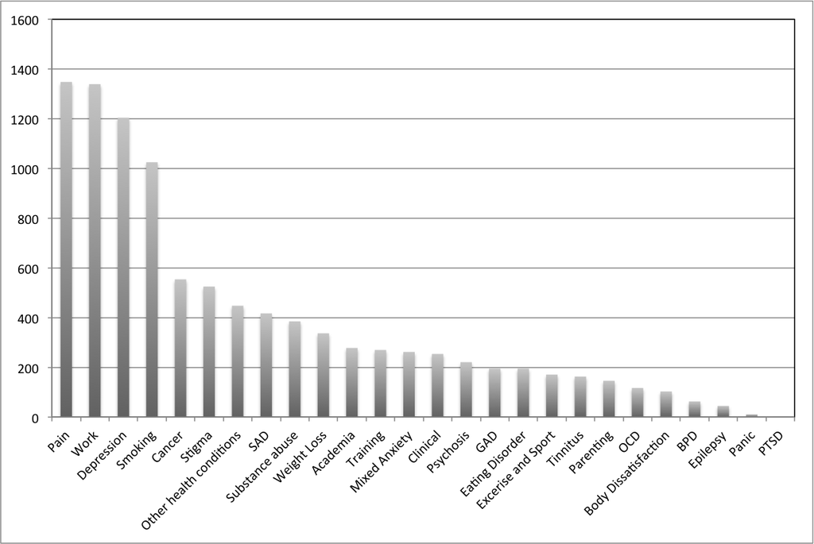
10,000+ ACT RCT participants

Slide 10
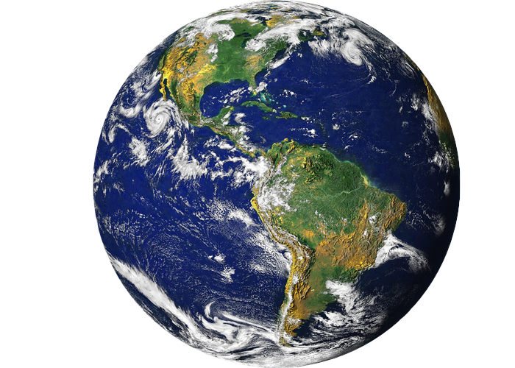

Slide 11
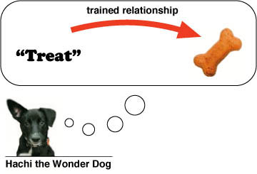
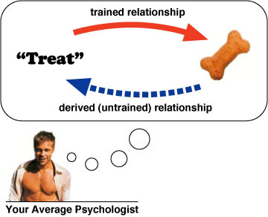
Relational Frame Theory
Source: Ironshrink

Slide 12
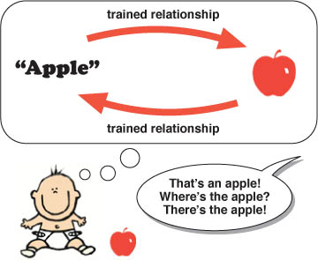
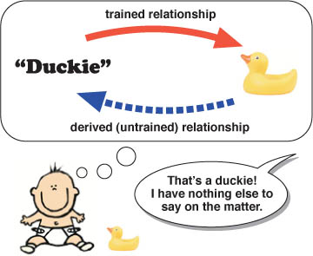
Practice makes perfect
After thousands of such interactions, the child no
longer requires explicit bi-directional training
Source: Ironshrink

Slide 13
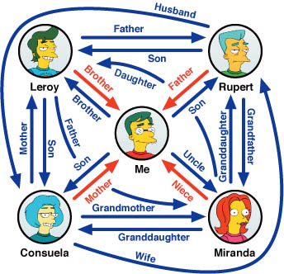
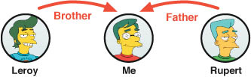
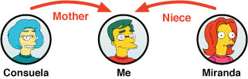
Complex relational framing behaviour
Source: Ironshrink
Trained relations
Derived relations
There are assumptions involved. Maybe Rupert and Consuela were never married, or maybe Miranda is not Leroy’s daughter. Relational framing is prone to certain types of errors that can affect mental health. We’ll come back to that!

Slide 14
Derivation
A
B
Worth More
C
?
Worth More

Slide 15
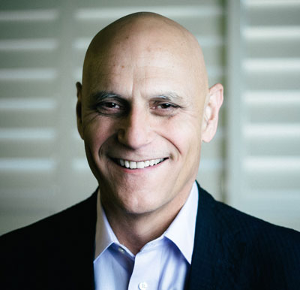
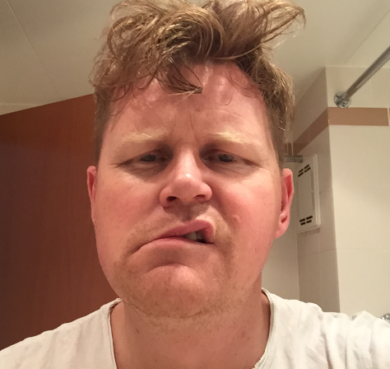
Derivation
A
B
Same
C
?
Opposite
Notes:
Derive the relation between A and C, given same and opposite relations
Intelligence
Charm
Looks

Slide 16
Multiple relational frames
Same and different
Faster and slower
Bigger and smaller
Worse and better
Stronger and weaker
Closer and further
Mine and yours
Happy and sad
…and so on.

Slide 17
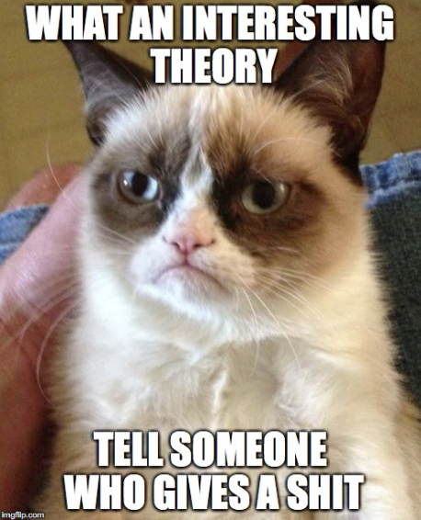

Slide 18
Dominance of Verbal Relations
Humans are able to arbitrarily relate pretty much anything (including objects, events, thoughts, feelings, actions, and more) to anything else
Therefore, anything can be arbitrarily related to pain and aversive stimuli

Slide 19
“Dentist”
Pain
Notes:
Black v white
Kiki bouba
Mary had a little lamb

Slide 20
Dominance of Verbal Relations
Three relations we use a lot in problem solving, planning, and comparing outcomes:
  Hierarchical relations – events and their attributes (A is a member of B; A has attributes B, C, D)
  Temporal and/or contingency relations (A happens before/causes B)
  Evaluative/comparative relations (A is better than B)
What happens when we apply these relations to everything in our lives?

Slide 21
Experiential Avoidance
Thinking of painful events or memories can itself be painful and aversive
Avoiding or escaping aversive stimuli and events works pretty well for external stimuli…
…so we will often try to avoid or escape our aversive internal stimuli (thoughts, feelings, emotions, etc.) – experiential avoidance
https://www.youtube.com/watch?v=C-ZuqeyxULM

Slide 22
Cognitive Fusion
Rules may continue to be followed even if they are inaccurate, ineffective, or harmful
Rigid rule-governance can result in psychological inflexibility
  Rules may prevent contact with actual contingencies in environment (and consequences of the behavior) – cognitive fusion

Slide 23
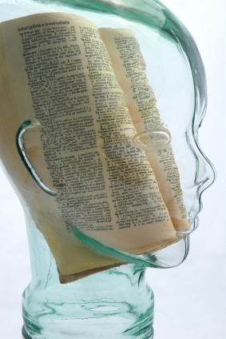
Cognitive Fusion
We get caught up in the products of our minds
We cannot distinguish a verbally-based and evaluated world from the world as directly experienced through the senses
Notes:
Our minds are so smooth, that we barely even notice it’s working…we get caught up in products of our thinking without noticing the process. So comparisions, evaluations, judgments, appraisals, interpretations seem as real and true as perceiving the color blue
The two become fused into one world.
Thoughts are like a clear, plastic bubble over our head.
We just end up with the products of thought (functions) and miss the process of relating.

Slide 24
Therapeutic stance in ACT
Our clients are stuck…not broken or sick
The processes that get them stuck are normal, expected “side effects” of language
Human suffering is not a disease

Slide 25

Diagnostic criteria for the Human Condition
Criterion A. The person experiences one or more of the following events:
1) Thoughts
2) Feelings
3) Sensations
Criterion B. The person engages in behavior aimed at reducing, eliminating, changing, preventing, seeking, or otherwise controlling the Criterion A events.
Criterion C. The behaviors described in Criterion B cause clinically significant distress, which may result in impairment in social, occupational, or other important areas of functioning.
Specify if: There can be more to life than the experiences and behaviors described in Criteria A and B, respectively.
Slide inspired by Paul Gunthier

Slide 26
Therapeutic stance in ACT
The problem is not the problem – the solution is the problem
You can’t rescue clients from the difficulty and challenge of growth
If you step outside your comfort zone, you get discomfort

Slide 28
The targets of ACT
The ineffective and inflexible ‘change’ agenda
Experiential avoidance
Cognitive fusion – the inability to differentiate self and behaviour from private events
Inability to make and keep a commitment to actions consistent with valued life directions

Slide 29
Psychological Flexibility
Psychological flexibility is…
  being more present to your experience in any given moment, and based on what the situation affords, noticing your thoughts and values, and choosing the most workable course of action
  The overarching aim of ACT
  Shown to mediate outcome in 1000 studies

Slide 30
Once more, in English this time?
Living a richer, fuller life with less struggle
Open, Aware, and Active
Notes:
30

Slide 31
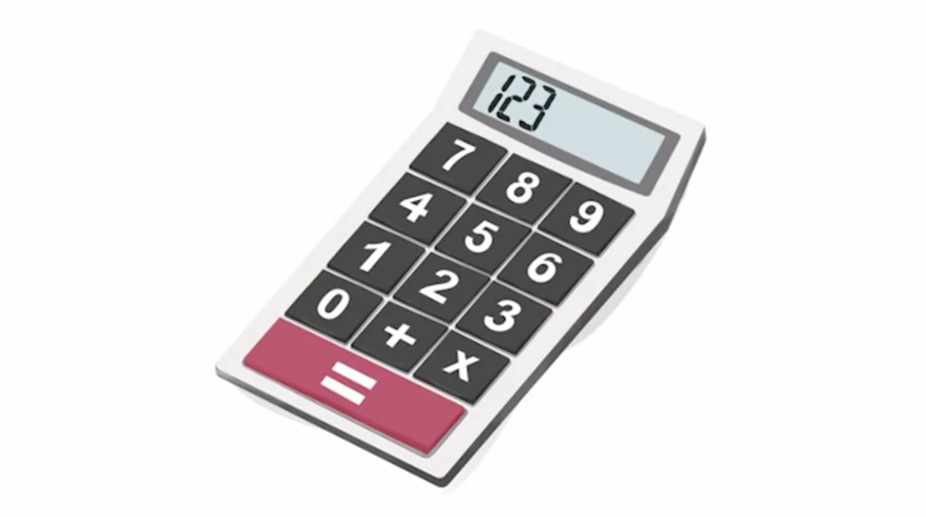

Slide 32
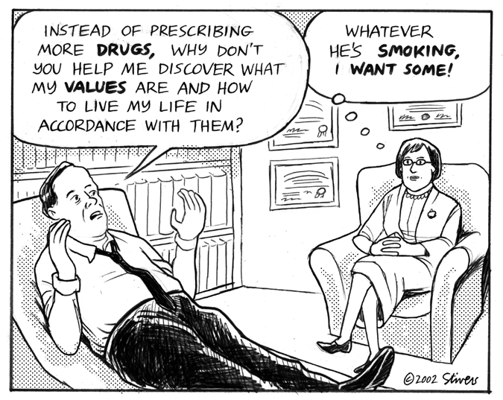

Slide 33

Sitting with your own thoughts?
(Wilson, et al. 2014)
Notes:
Experiment - being with thoughts vs. electric shocks
Discomfort with own thoughts - relationship with phones etc.
Put away distractions and enterain themselves with their own thoughts 6-15 mins
Given change to shock themsleves if desired
Chance to see how painful
Among those who said they would pay money not to feel shock
¼ woment and 2/3 men zapped themselves
One pressed button 190 times
Lead researcher said “I’m still just puzzled by that.”
Virginia

Slide 34
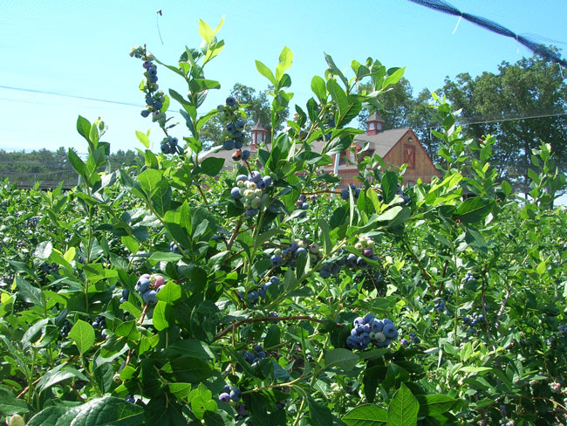

Slide 35
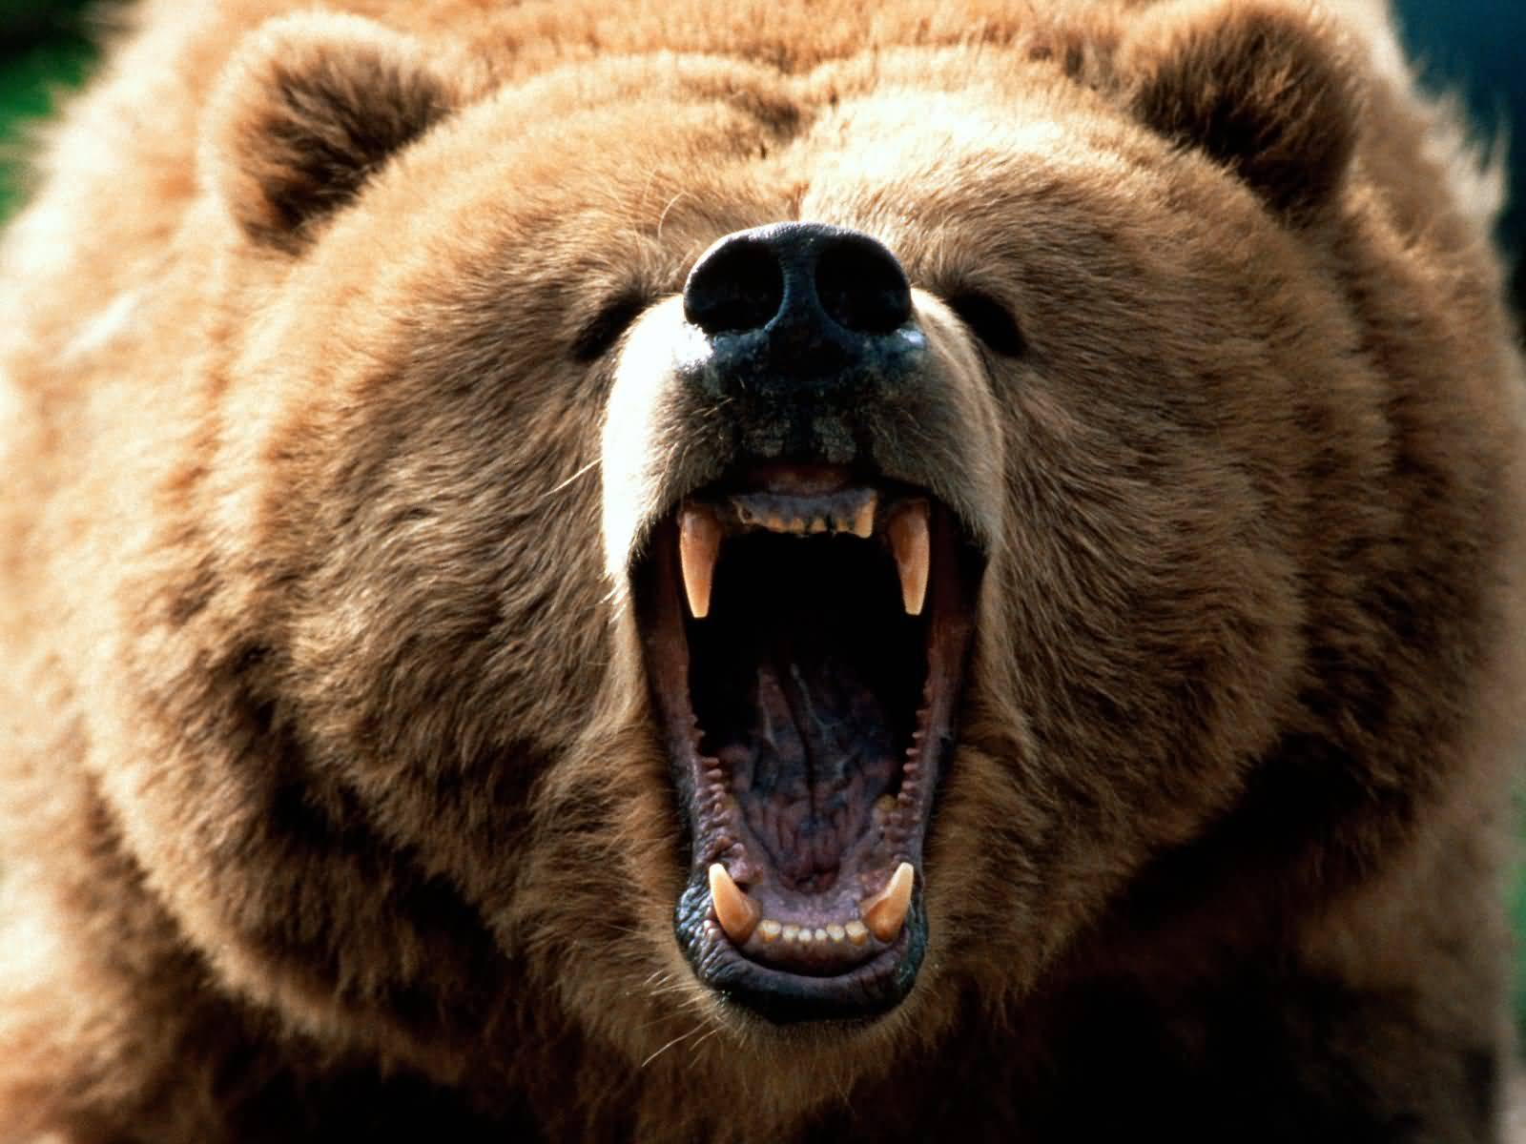
Human motivation

Slide 36
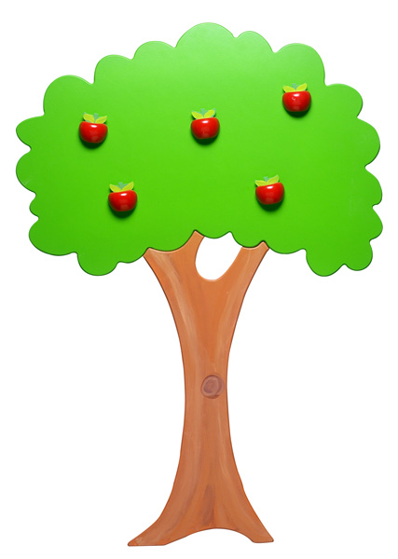

Away
Toward

Slide 37
Think of something you’ve achieved that you’re proud of...

Slide 38
Actions to move
Away
(or under the control) from what you don’t want to think or feel
Toward
who or what is important to you
vs.
This is the central discrimination

Slide 39
Values
Clarifying and connecting with one’s values makes life meaningful
It helps to define
  What sort of person you want to be
  What you want to stand for in life
  What motivates you to make change or pick challenges
The aim of values work is to increase the frequency of valued living

Slide 40
Values are:
Notes:
40

Slide 41
Values v goals
Goals specify a destination
Values specify the overall direction
The compass metaphor
  What is the value that is orientating you in that particular direction?
  https://www.youtube.com/watch?v=T-lRbuy4XtA
Discriminating the ‘what’ from the ‘why’
  https://www.youtube.com/watch?v=LZe5y2D60YU

Slide 42
Stanford Study
(Cohen & Sherman 2006)
Brief values exercise
Compared impact on poor performing minority high school students
42

Slide 43
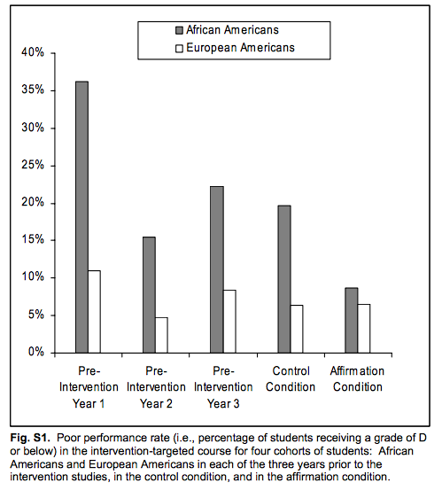
How long was this effect apparent?
2 YEARS
(As reported in Science)
43

Slide 44
Pick the Top 3 most important values to you
Athletic ability
Being good at art
Creativity
Independence
Living in the moment
Membership in a social group (such as your community, group, or club)
Music
Politics
Relationships with friends or family
Religious values
Sense of humor

Slide 45
Part 2
Look at the values you picked as most important to you. Pick one and think about times when this value was most important to you. Write a few sentences about why the value you selected is important to you.
Focus on your thoughts and feelings, and don’t worry about spelling, grammar, or how well written it is

Slide 46
Benefits for Clients?
Impact on important outcomes: mental health, wellbeing, increased resilience to stress and pressure (Cohen & Sherman, 2014; Steger, 2012)
Behaviour under “appetitive” control more flexible and creative (Friedman & Forster, 2001)
Notes:
cc

Slide 47

Values Pain

Slide 48
What values could be connected to these thoughts?
I’m anxious no one will like me
I can’t see the point in my work
I’m scared to let people get close to me
I’m worthless compared to everyone else
I’m going to fail
Everyone disrespects me

Slide 49
What unwanted thoughts/ feeling could be connected to these values?
Creating deep connections to others
Engaging in meaningful work
Being spontaneous and creative
Being adventurous
Giving care and compassion

Slide 50
Exercise 2
Choose three moments from your life that really stand out in terms of connecting you with what matters
  One-off or repeated experiences
  Pleasant or unpleasant
  Times when you felt really connected to what matters most
Select the most precious one
What is the value that this moment represents?
What change could you make this week that would bring you closer to a life that connects you to this value?

Slide 51
Exercise 2
How does the goal you just identified compare with the goal that you identified at the start of the talk?
Which one feels most meaningful to you?
If you were asked to complete one or the other, which one would you feel most inclined towards?

Slide 52
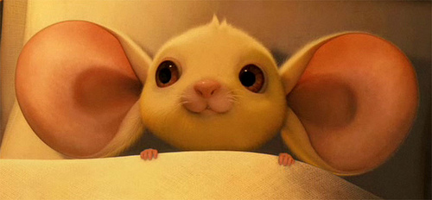
Notes:
Listen with Values Ears

Slide 53
Values techniques
The ‘two sides of the paper’ exercise
A letter back from your 80th birthday
What would you like inscribed on your headstone?
The ‘other’ miracle question
  If a miracle happened and you automatically had the approval of everyone who matters to you (and therefore, never had to please or impress anyone), what would you do with your life?
Values questionnaires
Values card sort

Slide 54
Committed action
Values can be translated into goals of therapy
  Prompting people to build a life around their values and not their thoughts
  Specifying short/medium/long term value-driven goals and action
  Planning and scheduling value driven activities
  Identifying internal obstacles and committing to use techniques to help manage them
  Supercharging behavioural activation

Slide 55
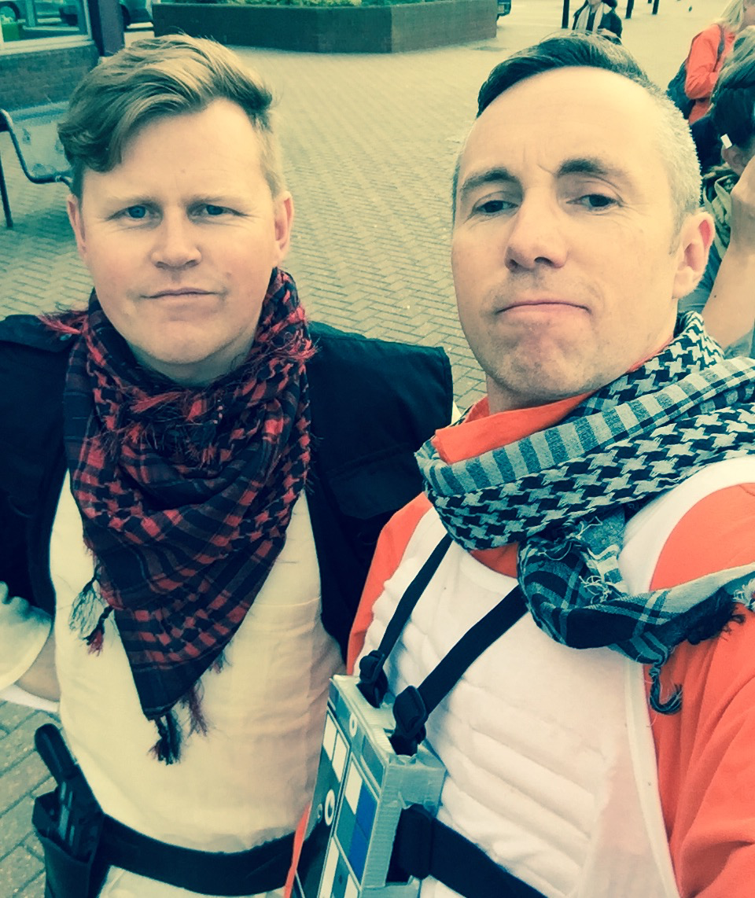

Slide 56
Act the way you'd like to be and soon you'll be the way you act.
Leonard Cohen
(ACT therapist)

Slide 57

Figure out what you care about…
and care about it
(Ben Sedley)

Slide 59
Contact details
www.thinkpsychology.co
info@thinkpsychology.co
@thinkpsychol
and University of Birmingham
Rich
Joe
  www.contextualconsulting.co.uk
  joe@contextualconsulting.co.uk
  @contextconsult
  and University College London

Slide 60
Further information
  www.contextualscience.org
  Information / articles / resources / listserve / love
  Values-based membership fee

